Slide 1
Software environments organization

Slide 2
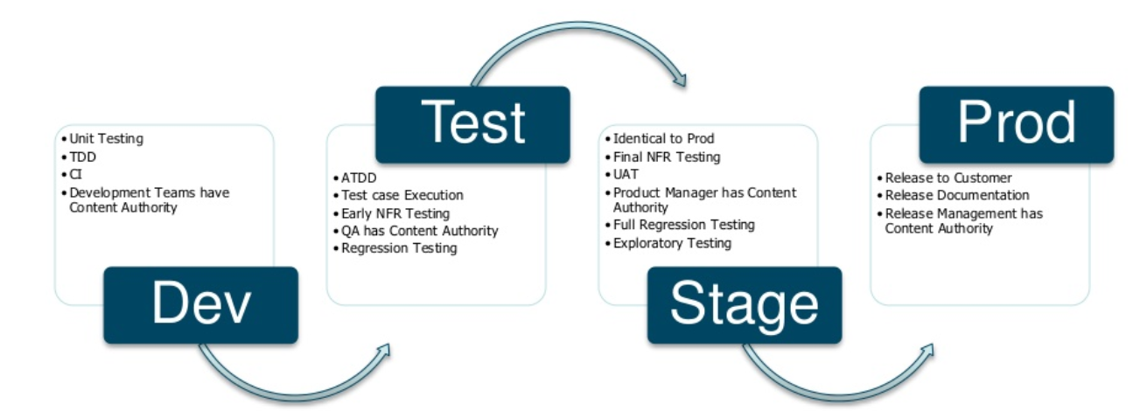

Slide 3
Development
The development environment (dev) is the environment in which changes to software are developed, most simply an individual developer's workstation. This differs from the ultimate target environment in various ways – the target may not be a desktop computer (it may be a smartphone, embedded system, headless machine in a data center, etc.), and even if otherwise similar, the developer's environment will include development tools like a compiler, integrated development environment, different or additional versions of libraries and support software, etc., which are not present in a user's environment.
In the context of revision control, particularly with multiple developers, finer distinctions are drawn: a developer has a working copy of source code on their machine, and changes are submitted to the repository, being committed either to the trunk or a branch, depending on development methodology. The environment on an individual workstation, in which changes are worked on and tried out, may be referred to as the local environment or a sandbox. Building the repository's copy of the source code in a clean environment is a separate step, part of integration (integrating disparate changes), and this environment may be called the integration environment or the development environment; in continuous integration this is done frequently, as often as for every revision. The source code level concept of "committing a change to the repository", followed by building the trunk or branch, corresponds to pushing to release from local (individual developer's environment) to integration (clean build); a bad release at this step means a change broke the build, and rolling back the release corresponds to either rolling back all changes from that point onward, or undoing just the breaking change, if possible.

Slide 4
Testing
The purpose of the test environment is to allow human testers to exercise new and changed code via either automated checks or non-automated techniques. After the developer accepts the new code and configurations through unit testing in the development environment, the items are moved to one or more test environments.^{[3]} Upon test failure, the test environment can remove the faulty code from the test platforms, contact the responsible developer, and provide detailed test and result logs. If all tests pass, the test environment or a continuous integration framework controlling the tests can automatically promote the code to the next deployment environment.
Different types of testing suggest different types of test environments, some or all of which may be virtualized^{[4]} to allow rapid, parallel testing to take place. For example, automated user interface tests^{[5]} may occur across several virtual operating systems and displays (real or virtual). Performance tests may require a normalized physical baseline hardware configuration, so that performance test results can be compared over time. Availability or durability testing may depend on failure simulators in virtual hardware and virtual networks.
Tests may be serial (one after the other) or parallel (some or all at once) depending on the sophistication of the test environment. A significant goal for agile and other high-productivity software development practices is reducing the time from software design or specification to delivery in production.^{[6]} Highly automated and parallelized test environments are important contributors to rapid software development.

Slide 5
Staging
Staging is an environment for final testing immediately prior to deploying to production. It seeks to mirror the actual production environment as closely as possible and may connect to other production services and data, such as databases. For example, servers will be run on remote machines, rather than locally (as on a developer's workstation during dev, or on a single test machine during test), which tests the effect of networking on the system.
The primary use of a staging environment is to test all installation/configuration/migration scripts and procedures, before they are applied to production environment. This ensures that all major and minor upgrades to the production environment will be completed reliably without errors, in minimum time.
Another important use of staging is for performance testing, particularly load testing, as this often depends sensitively on the environment.

Slide 6
Production
The production environment is also known as live, particularly for servers, as it is the environment that users directly interact with.
Deploying to production is the most sensitive step; it may be done by deploying new code directly (overwriting old code, so only one copy is present at a time), or by deploying a configuration change. This can take various forms: deploying a parallel installation of a new version of code, and switching between them with a configuration change; deploying a new version of code with the old behavior and a feature flag, and switching to the new behavior with a configuration change that performs a flag flip; or by deploying separate servers (one running the old code, one the new) and redirecting traffic from old to new with a configuration change at the traffic routing level. These in turn may be done all at once or gradually, in phases.
Deploying a new release generally requires a restart, unless hot swapping is possible, and thus requires either an interruption in service (usual for user software, where applications are restarted), or redundancy – either restarting instances slowly behind a load balancer, or starting up new servers ahead of time and then simply redirecting traffic to the new servers.
When deploying a new release to production, rather than immediately deploying to all instances or users, it may be deployed to a single instance or fraction of users first, and then either deployed to all or gradually deployed in phases, in order to catch any last-minute problems. This is similar to staging, except actually done in production, and is referred to as a canary release, by analogy with coal mining. This adds complexity due to multiple releases being run simultaneously, and is thus usually over quickly, to avoid compatibility problems.

